Slide 1
Cycling Emergencies: A Basic Approach
Marc Taub, M.D.
Medical Director
MemorialCare Saddleback Medical Center
Emergency Department

Slide 2
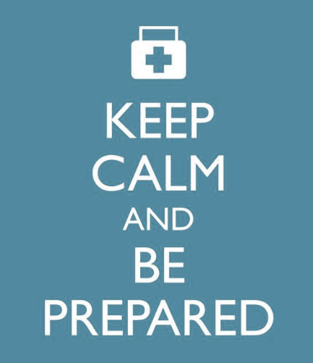
How ER Doctors and Nurses think…
Hope for the best, plan for the worst.

Slide 3
Situational Awareness (S.A.)
Definition: An up to the minute awareness of one’s situation
Physical state
Mental state
Equipment
Environment
Teammates
Remember: Loss of SA leads to human error!

Slide 4
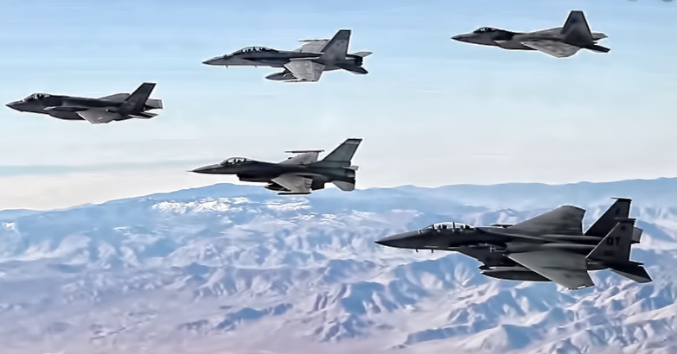
Check Six

Slide 5
Stay Calm, Be Prepared with a Basic Approach
CAB
Compressions
Airway
Breathing
ABC
Airway
Breathing
Circulation

Slide 6
An Approach to Disasters, Multivictim, and Violent Events
RACE
React- Run, hide, fight
Activate 911
Care for the injured
Evacuate
CARE
Control Bleeding
Airway
Respirations
Exposure

Slide 7
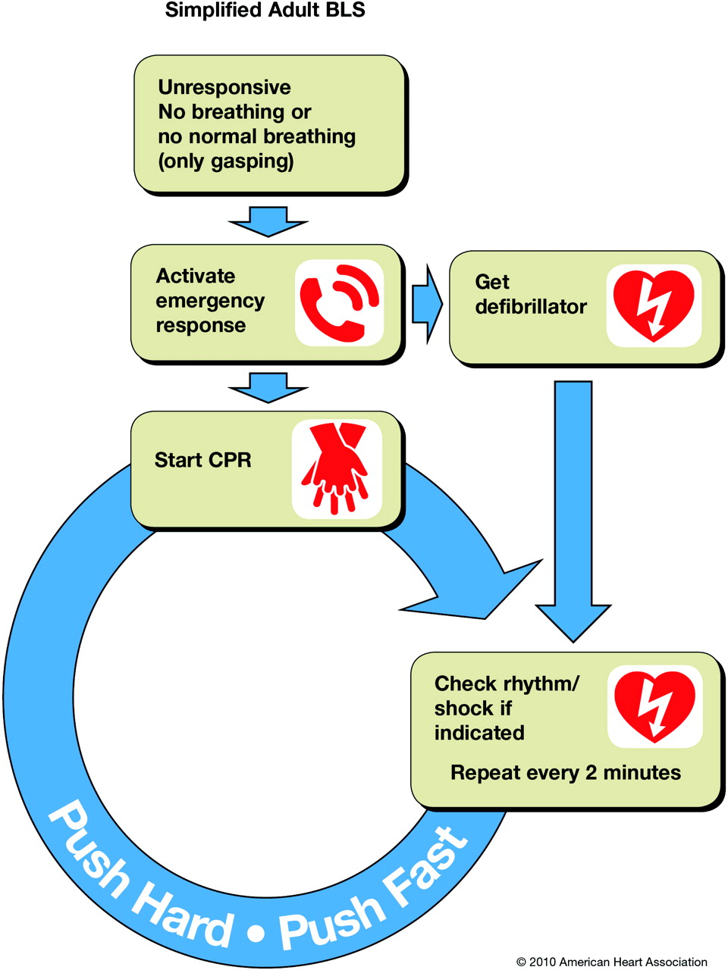
Unresponsive victim = Basic Life Support

Slide 8
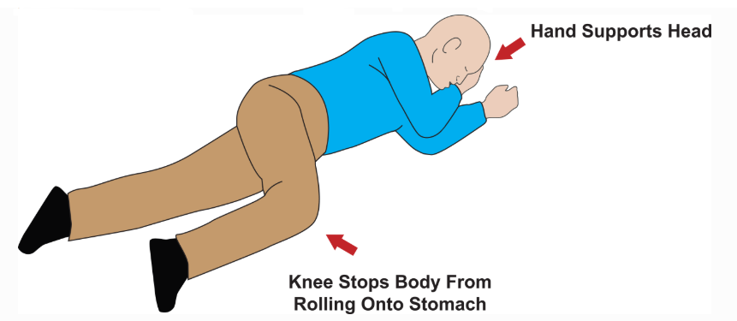
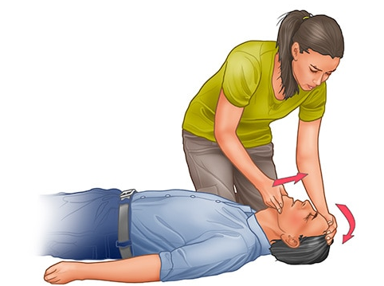
A: Airway - is it clear, can they speak?
Rescue/Recovery Position
Head Tilt/Chin Lift

Slide 9
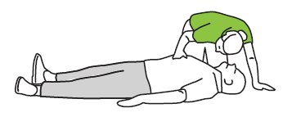
B: Breathing - are they breathing adequately?
Look, listen, feel

Slide 10
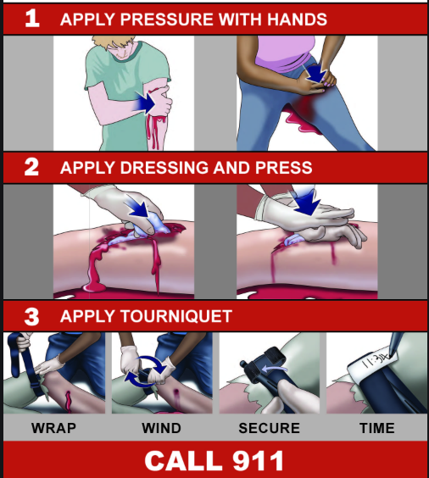
C: Circulation - Are they bleeding? Is there a pulse?

Slide 11
Stop the Bleed- To Do List
Take a Stop the Bleed Course
Buy a Stop the Bleed Kit online
Download “First Care Provider” App

Slide 12
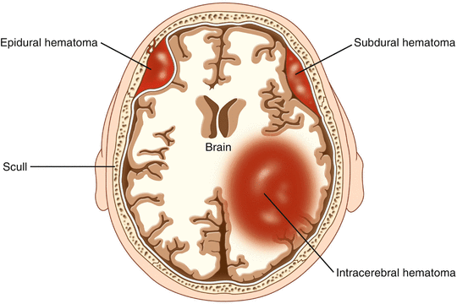
Traumatic Head Injuries

Slide 13
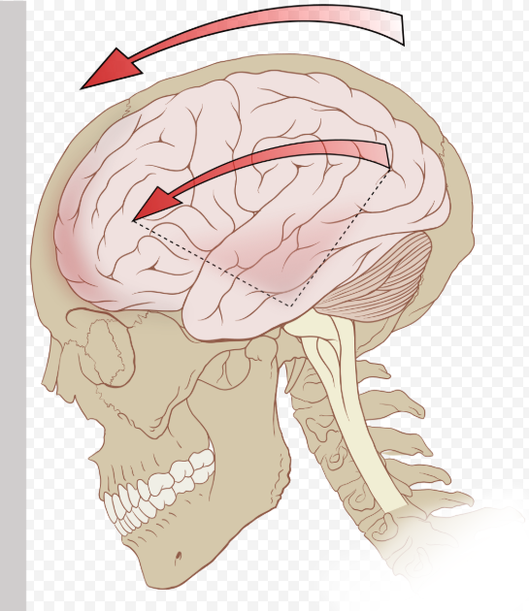
Traumatic Brain Injury: Concussion
Loss of consciousness
Confusion
Headache
Blurred Vision
Repetitive speech
Amnesia
Nausea and vomiting

Slide 14
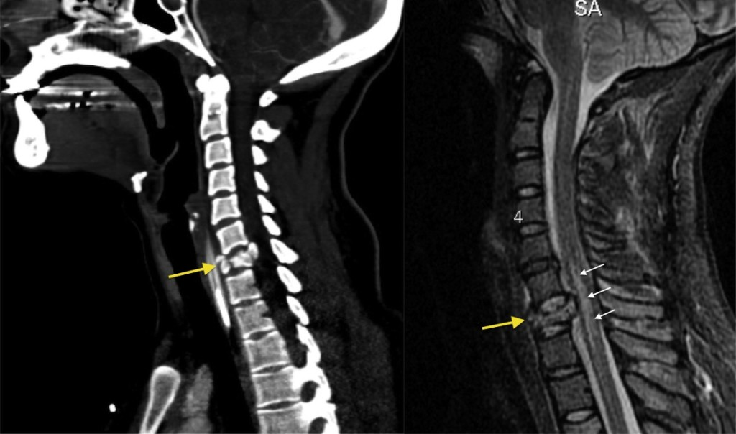
Spinal Injuries

Slide 15
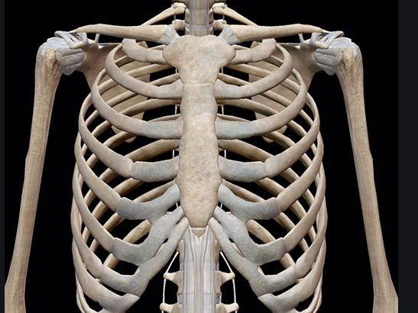
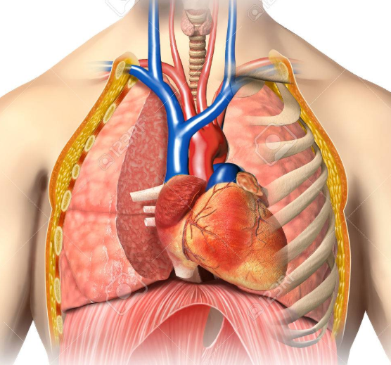
Chest Wall / Upper Torso Trauma

Slide 16
Chest Pain
Three Deadly Causes
Heart Attack
Pulmonary Embolus
Aortic Dissection
Warning Signs
Severe pain
Shortness of breath
Radiation to other areas
Vomiting/sweating
Fainting
Cardiac History

Slide 17
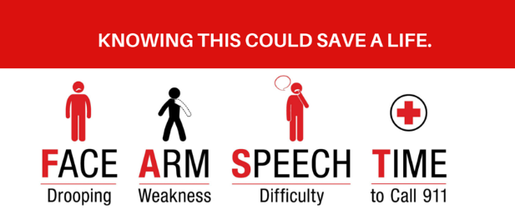
Stroke

Slide 18
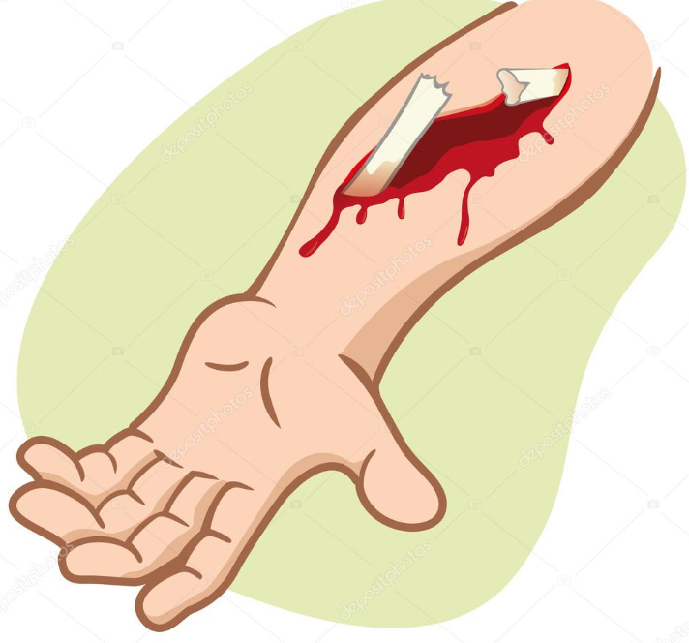
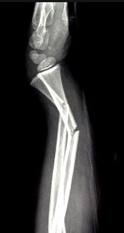
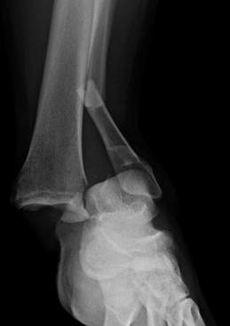
Extremity Trauma
Open “compound” fracture
Angulated fracture
Fracture Dislocation

Slide 19
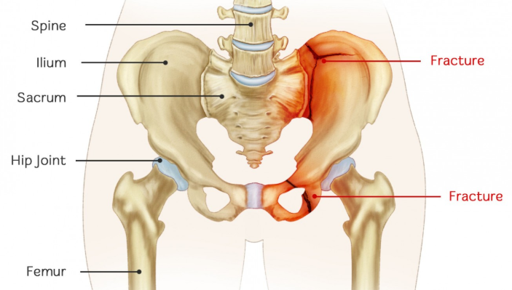
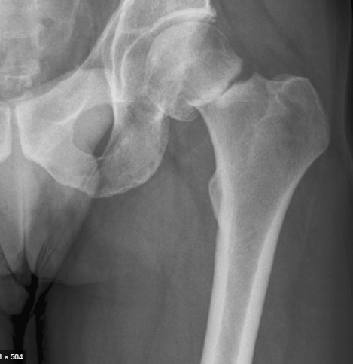
Pelvic Trauma
Pelvic Fractures
Hip Fracture

Slide 20
Summary
Hope for the best, plan for the worst
Develop, monitor, maintain Situational Awareness
Check Six with your teammates
Memorize and use a simple plan for emergencies-ABC, CAB, RACE, CARE
Purchase a Stop the Bleed Kit and take training
Take CPR training

Slide 21
Questions?

Slide 22
Thank you.

